Slide 1
Introduction to Object-Oriented Programming

Slide 2
Course Outlines
Introduction to Classes, Objects and Methods
Array and ArrayList
Composition
Inheritance
Polymorphism
File Handling
GUI
2d Graphics

Slide 3
Lecture-wise distribution of the course contents
Lecture # | CDF Unit # | Topics Covered | Reading Material
1. | 1 | Evolution of Object-Oriented Programming (OOP); Difference between Object Oriented Approach & Modular/Structural Approach, and Object-Oriented Concepts & Principles. | Deitel: Ch01 Tttttts'[;`pLiang: Ch10
2. | 2 | Definition of Classes: Fields & Methods, Creation of Objects, and Understanding State of Object. | Deitel: Ch03, 06
3. | 2 | Defining Constructors, and Concept of Overloaded Constructors. | Deitel: Ch08
4. | 2 | Memory Allocation to Objects, Object as a Reference, Finalizer () Method, and Garbage Collection. | Liang: Ch9
5. | 2 | Object-Oriented Idioms for Encapsulation: Privacy & Visibility of Class Members, and Package Access. | Deitel: Ch08
6. | 2 | Passing & Returning Objects from Methods, This Operator, and Copy Constructors. | Deitel: Ch08
7. | 2 | Static Data, and Methods. | Deitel: Ch08
8. | 2 | Arrays | Deitel: Ch07
9. | 2 | Arrays Object | Deitel: Ch07
10. | 2 | Immutable Classes, and String as Immutable Class, Wrapper Classes. | Liang: Ch09,10

Slide 4
Continued…
11. | 3 | Class Diagram, Forward Engineering of Class Diagram to Code, Reverse Engineering of Code to Class Diagram, and Decomposition into Objects. | Liang: Ch9
12. | 3 | Composition, and Aggregation (Has–A Relationship). | Deitel: Ch09
13. | 3 | Introduction to Inheritance & Subclasses, and Super Keyword. | Deitel: Ch09
14. | 3 | Constructor Chaining, Object-Oriented Idioms for Encapsulation, (Protected Access Specifier), and Final Modifier. | Deitel: Ch09
15. | 3 | Method Overriding, and Difference Between Overriding & Overloading. | Deitel: Ch09
16. | 3 | Object Class, and toString () Method. | Liang: Ch11
17. |  | Mid Term Exam
18.
19. | 4 | Polymorphism & Dynamic Binding, Notion of Behavioral Replacement (Subtypes Acting like Super-Types); and Relationship Between Sub-Typing & Inheritance. | Deitel: Ch10
20. | 4 | Down Casting & Up Casting, and Equals () Method of Object Class. | Deitel: Ch10

Slide 5
Continued…
21. | 4 | Abstract Classes, and Methods. | Deitel: Ch10
22. | 4 | Interfaces & their Usage, and Comparable & Cloneable Interfaces. | Deitel: Ch10
23. | 4 | Array List Class. | Deitel: Ch07
24. | 4 | Generic Types, and Static & Dynamic Typing. | Liang: Ch19
25. | 5 | Introduction to File Handling / Database Connectivity | Deitel: Ch15
26. | 5 | Binary Files (Object Streaming). /Database Connectivity | Deitel: Ch15
27. | 5 | Object Serialization. | Liang: Ch17
28. | 6 | GUI Components (Labels, Buttons, Text Field, Text Areas, Radio Buttons, Combo Box, List View, and Scroll Bar). | Liang: Ch16 & 14
29. | 6 | Containers, and Layout Managers. | Liang: Ch14
30. | 6 | Introduction to Event Driven Programming, and Events & Listeners. | Liang: Ch15
31. | 6 | Listeners as Inner Classes, Anonymous Inner Classes, and Event Handling using Lambda Expression. | Liang: Ch15
32. | 6 | Using Reactive Framework, Externally-Generated Events, Window Listeners, and Adapter Classes. | Savitch: Ch18

Slide 6
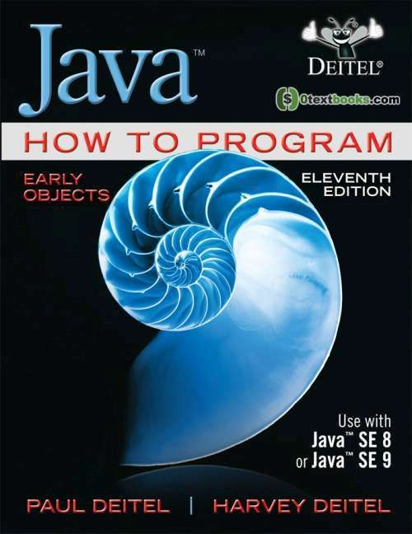
Book
Java How to Program, Eleventh Edition
Paul Deitel and Harvey Deitel

Slide 7
Programming Paradigm
Classification of programming languages based on its characteristics.
There are number of programming paradigms such as:
Procedural Programming Paradigm
Object Oriented Programming Paradigm
Declarative Programming Paradigm (HTML, SQL (Structured Query Language))
Notes:
HTML, SQL and embedded SQL are some of the well-known examples of declarative programming languages. Tools are provided to programmers in declarative programming to allow abstraction of the implementation and to help in the concentration of the issue.

Slide 8
Procedure Oriented Programming (POP)
Procedure Oriented Programming is a programming paradigm that is based on sub-routines or procedures also known as functions.
They consist of sequential steps that perform some specified task.
Features
Modularity
Predefined Function
Scoping
Parameter Passing
Libraries

Slide 9
Continued…
Advantages
General Purpose Programming
Modularity
Code reusability using function
Notes:
Lisp is favorable for AI related work.

Slide 10
Problems with POP
As programs grow ever larger and more complex, even the structured programming approach begins to show signs of strain.
You may have heard about, or been involved in, horror stories of program development
The project is too complex
The schedule slips
More programmers are added
Complexity increases
Costs skyrocket
The schedule slips further and
Disaster ensues.

Slide 11
Continued…
Analyzing the reasons for these failures reveals that there are weaknesses in the procedural paradigm itself.
No matter how well the structured programming approach is implemented, large programs become excessively complex.
What are the reasons for these problems with procedural languages?
Function have unrestricted access to global data.
Second, unrelated functions and data, the basis of the procedural paradigm, provide a poor model of the real world.

Slide 12
Why O-O?
Object-oriented programming was developed because limitations were discovered in earlier approaches to programming.
Procedural Languages
C, Pascal, FORTRAN, and similar languages are procedural languages.
Each statement in the language tells the computer to do something: Get some input, add these numbers, divide by six, display that output.
A program in a procedural language is a list of instructions.
For very small programs, no other organizing principle (often called a paradigm) is needed. The programmer creates the list of instructions, and the computer carries them out.

Slide 13
Division into Functions
A procedural program is divided into functions (if the program size is large), and (ideally, at least) each function has a clearly defined purpose and a clearly defined interface to the other functions in the program.
The idea of breaking a program into functions can be further extended by grouping a number of functions together into a larger entity called a module (which is often a file).
The principles similar: a grouping of components that execute lists of instructions.

Slide 14
CASE STUDY
Let’s examine these problems in the context of a library program. One important global data item in such a program is the collection of items (Books, CDs, Thesis, Journals, etc.) in the library. Various functions access this data to
input a new item
display an item
modify an item
and so on.

Slide 15
1- Unrestricted Access
In a procedural program, one written in C for example, there are two kinds of data.
Local Data
Local data is hidden inside a function, and is used exclusively by the function.
In the library program, a display function might use local data to remember which item it was displaying.
Local data is closely related to its function and is safe from modification by other functions.
Global Data
However, when two or more functions must access the same data—and this is true of the most important data in a program—then the data must be made global, As our collection of library items.
Global data can be accessed by any function in the program.

Slide 16
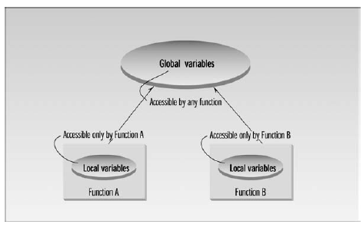
Global And Local Variable

Slide 17
Continued…
Lack of Modularity: Structural programming doesn't provide a robust way to modularize code. As programs grow in size and complexity, it becomes challenging to organize and manage code without clear modular boundaries. This can lead to code that is hard to read, maintain, and debug.
Global Variables: In structural programming, global variables are often used to share data between different parts of the program. This can lead to unintended side effects, making it difficult to trace the flow of data and identify the source of bugs.
Scalability Issues: Large-scale software projects can be challenging to manage with structural programming. As the size of the codebase grows, it becomes increasingly difficult to coordinate and control the development efforts.

Slide 18
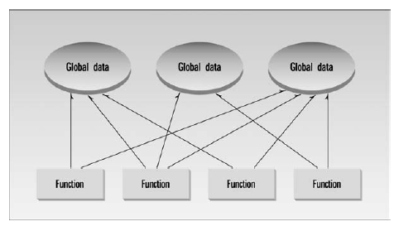
Procedural Paradigm

Slide 19
Large Number of Connections Causes Problems
First, it makes a program’s structure difficult to conceptualize.
Second, it makes the program difficult to modify. A change made in a global data item may necessitate rewriting all the functions that access that item.
For example, in our library program, someone may decide that the Accession Number for the library items should be changed from 5 digits to 12 digits. This may necessitate a change from a short to a long data type.
When data items are modified in a large program it may not be easy to tell which functions access the data, and even when you figure this out, modifications to the functions may cause them to work incorrectly with other global data items. Everything is related to everything else, so a modification anywhere has far-reaching, and often unintended, consequences.
Notes:
غیر ارادیunitended

Slide 20
2-Real-World Modeling
The second—and more important—problem with the procedural paradigm is that its arrangement of separate data and functions does a poor job of modeling things in the real world.
In the physical world we deal with objects such as people and cars.
Such objects aren’t like data and they aren’t like functions.
Complex real-world objects have both
attributes and
behavior

Slide 21
Attributes
Examples of attributes (sometimes called characteristics) are, for people, eye color and job title; and, for cars, horsepower and number of doors.
As it turns out, attributes in the real world are equivalent to data in a program: they have a certain specific values, such as blue (for eye color) or four (for the number of doors).

Slide 22
Behavior
Behavior is something a real-world object does in response to some stimulus/event.
If you ask your boss for a raise, she will generally say yes or no.
If you apply the brakes in a car, it will generally stop. Saying something and stopping are examples of behavior.
Behavior is like a function: you call a function to do something (display the inventory, for example) and it does it.
So, neither data nor functions, by themselves, model real-world objects effectively.

Slide 23
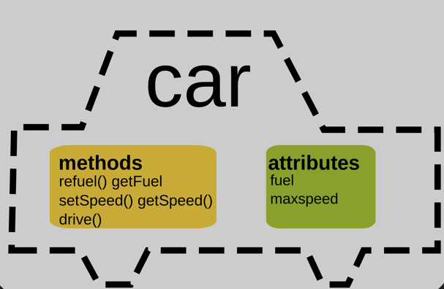
Example of Car
Attributes
model
color
current speed.
state
Function
start_engine
accelerate
Brake
turn_off_engine."

Slide 24
The Object-Oriented Approach
The fundamental idea behind object-oriented languages is to combine into a single unit both data and the functions that operate on that data. Such a unit is called an object.
An object’s functions, called member functions, typically provide the only way to access its data.
If you want to read a data item in an object, you call a member function in the object. It will access the data and return the value to you.
You can’t access the data directly. The data is hidden, so it is safe from accidental alteration.
Data and its functions are said to be encapsulated into a single entity.
If you want to modify the data in an object, you know exactly what functions interact with it: the member functions in the object. No other functions can access the data.
This simplifies writing, debugging, and maintaining the program.

Slide 25
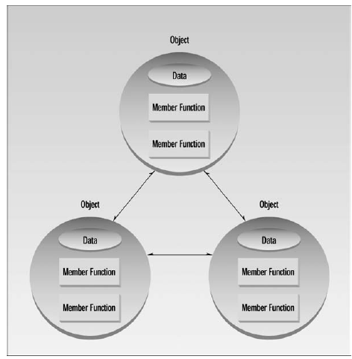
Example
A java program typically consists of number of objects, which communicate with each other by calling one another’s member functions.

Slide 26
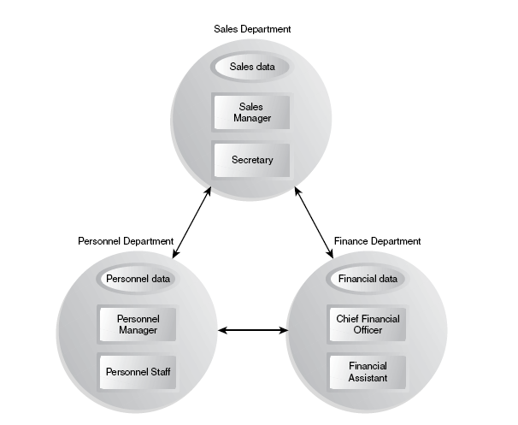
Real World Example

Slide 27
Characteristics of Object-Oriented Languages
Objects
When you approach a programming problem in an object-oriented language, you no longer ask how the problem will be divided into functions, but how it will be divided into objects.
Thinking in terms of objects, rather than functions, has a surprisingly helpful effect on how easily programs can be designed.
This results from the close match between objects in the programming sense and objects in the real world.

Slide 28
Characteristics of Object-Oriented Languages
Classes
Almost all computer languages have built-in data types. For instance, a data type int, meaning integer, is predefined in java . You can declare as many variables of type int as you need in your program:
In a similar way, you can define many objects of the same class. A class serves as a plan, or blueprint. It specifies what data and what functions will be included in objects of that class.
Defining the class doesn’t create any objects, just as the mere existence of data type int doesn’t create any variables.
An object is often called “instance” of a class.

Slide 29
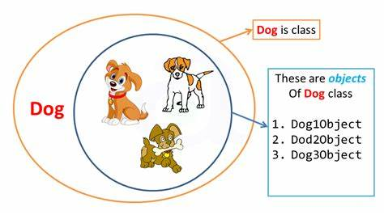

Slide 30
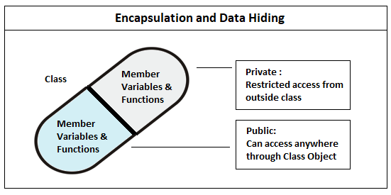
Characteristics of Object-Oriented Languages
Encapsulation and Data Hiding
Encapsulation enables you to hide the code and data into a single unit to secure the data from the outside world.
Encapsulation is a powerful feature that leads to information hiding.
Notes:
Act of enclosing in capsule

Slide 31
Characteristics of Object-Oriented Languages
Abstraction allows you to focus on what the object does instead of how it does it.
Example:
ATM Class Design; operations of the ATM machine like cash withdrawal, money transfer, retrieve mini-statement…etc.
There are two ways to achieve abstraction in java
Abstract class (0-100%)
Interface (100%)

Slide 32
Comparison
Parameter | Abstraction | Encapsulation
Focus | Abstraction allows you to focus on what the object does instead of how it does it | Encapsulation enables you to hide the code and data into a single unit to secure the data from the outside world.
Implementation | You can use abstraction using Interface and Abstract Class. | You can implement encapsulation using Access Modifiers (Public, Protected & Private.)
Focuses | Focus mainly on what should be done. | Focus primarily on how it should be done.
Application | During design level. | During the Implementation level.

Slide 33
Characteristics of Object-Oriented Languages
Inheritance
The idea of classes leads to the idea of inheritance.
In our daily lives, we use the concept of classes divided into subclasses. We know that the animal class is divided into
The mammal class is divided into insects, birds, and so on.
The vehicle class is divided into cars, trucks, buses, motorcycles, and so on.
The principle in this sort of division is that each subclass shares common characteristics with the class from which it’s derived.
Cars, trucks, buses, and motorcycles all have wheels and a motor; these are the defining characteristics of vehicles.
In addition to the characteristics shared with other members of the class, each subclass also has its own particular characteristics:
Buses, for instance, have seats for many people, while trucks have space for hauling heavy loads.

Slide 34
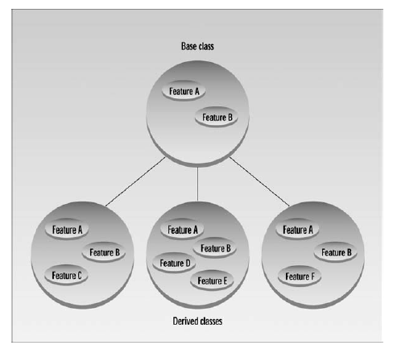
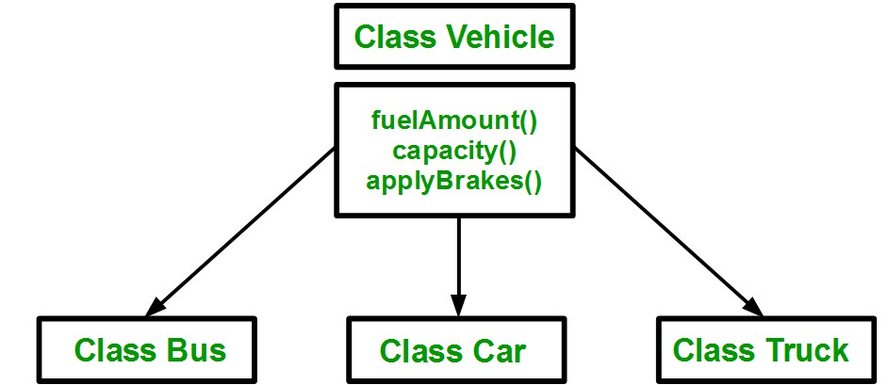
Characteristics of Object-Oriented Languages

Slide 35
Characteristics of Object-Oriented Languages
In a similar way, an OOP class can become a parent of several subclasses.
The original class is called the base class; other classes can be defined that share its characteristics, but add their own as well. These are called derived classes.
Inheritance is somewhat analogous to using functions to simplify a traditional procedural program.

Slide 36
Characteristics of Object-Oriented Languages
Reusability
Once a class has been written, created, and debugged, it can be distributed to other programmers for use in their own programs.
This is called reusability. It is similar to the way a library of functions in a procedural language can be incorporated into different programs.
However, in OOP, the concept of inheritance provides an important extension to the idea of reusability. A programmer can take an existing class and, without modifying it, add additional features and capabilities to it.
This is done by deriving a new class from the existing one. The new class will inherit the capabilities of the old one, but is free to add new features of its own.

Slide 37
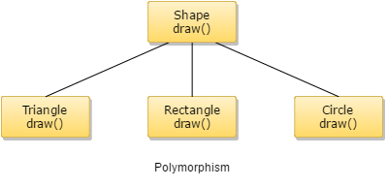
Characteristics of Object-Oriented Languages
Creating New Data Types
Polymorphism
Polymorphism (one thing with several distinct forms).
Single interface having multiple implementations

Slide 38
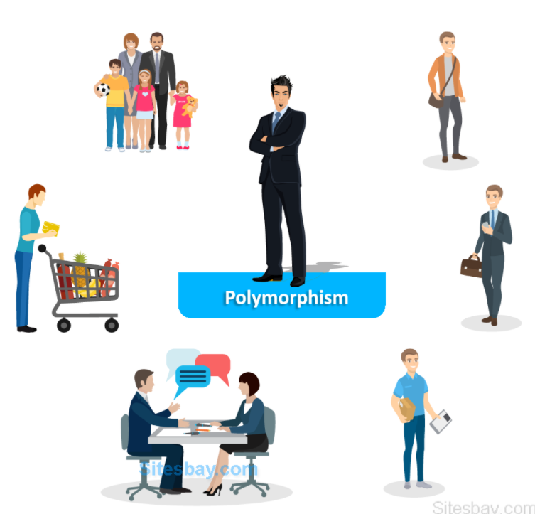
Real-world example of polymorphism

Slide 39
Continued…
A security guard outside an organization behaves differently with different people entering the organization.
He acts in a different way when the Boss comes and, in another way when the employees come.
When the customers enter, the guard will respond differently.
So here, the behaviour of the guard is in various forms, which depends on the member who is coming.

Slide 40
Questions

Slide 41
Aptitude Test
Create a structure of type book having following data items
AccNo of type integer
Title of type String
Status of type character
Write following functions and call them in main()
Input(): This function will initialize a structure variable of type book
Ouput(): This function will print the value of structure variable.

